Slide 1
Air Quality Analysis and Prediction Using Machine Learning Models
DAB 422 Capstone Project 2 - Group 5
Team Members:
Gowtham Chandu
Sanjana Indu,
Venkata Dhanayya
LingFang He
Kenechukwu Enem
Date: 19 July 2025

Slide 2




Problem Statement & Research Questions
Urban Air Pollution Threat
Key Research Questions
WHO Guideline Alignment
We investigate trends, seasonal variations, and meteorological impacts. Can ML forecast AQHI and pollutants? How do city factors shape air quality?
Our research aligns with WHO 2021 guidelines for air quality management. This guides our approach.
Urban air pollution, like PM2.5 and SO2, poses health risks. Industrial and traffic sources cause significant variations.

Slide 3

Dataset Information
Data Source
Pollutant Data: Air Quality Ontario (PM2.5, NO2, O3, etc.)
Weather Data: Environment Canada (Temperature, Humidity, etc.)
Time Frame: 2021 to 2023
We use hourly data from January 2021-December 2023.
Five Ontario Cities
Data covers Windsor, Hamilton Downtown, London, Sarnia, and Toronto.
Data Quality & Volume
Outliers and missing data was imputed by rolling average.
Each city has ~26,280 hourly records.

Slide 4





Methodology
Data Preprocessing
Handle missing values and normalize data.
Exploratory Data Analysis (EDA)
Analyze time-series plots, correlations, and seasonal variations.
Feature Engineering
Pollutant (PM2.5, O3, NO₂) and Weather (Temperature, Humidity)
Modeling
Utilize Random Forest, LightGBM, and XGBoost models.
Validation
Assess models using Accuracy, RMSE, and R-squared

Slide 5
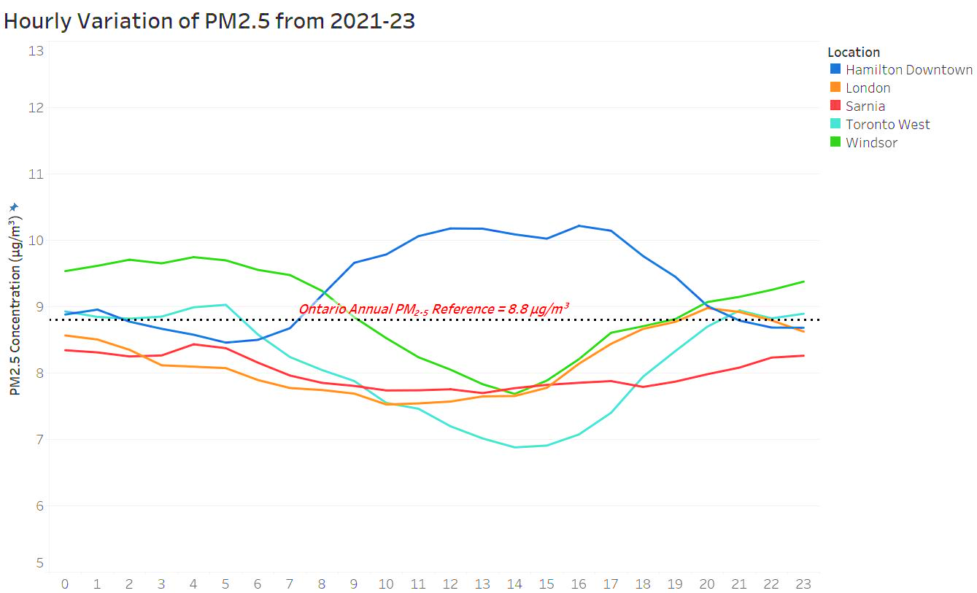
Exploratory Data Analysis
Key Insights
Daily Trends:
PM2.5 and NO2 spike during traffic hours; O3 peaks around noon.
Geographical Differences:
Hamilton: Higher pollutant levels during mid day.

Slide 6
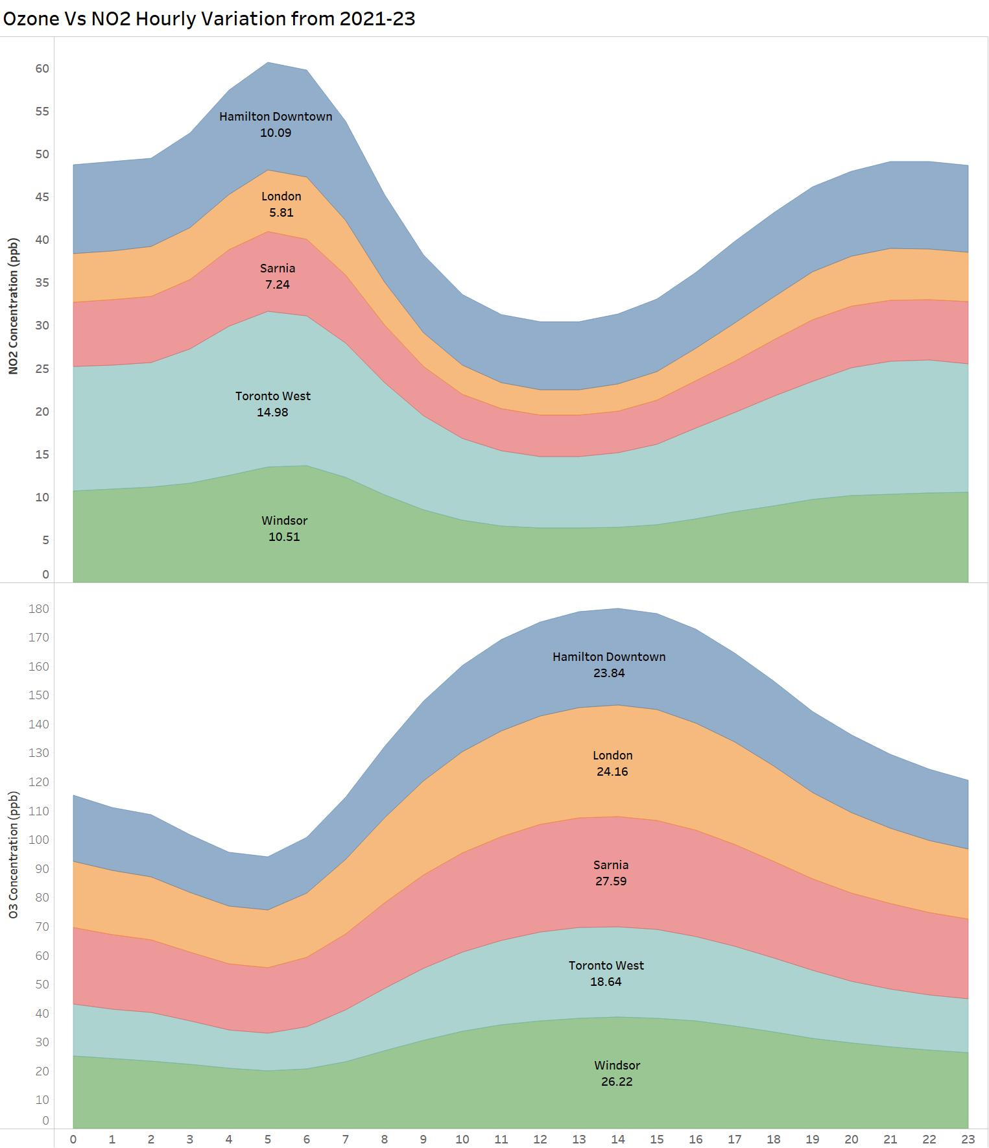
Exploratory Data Analysis
Key Insights
Inverse Correlation:
O3 and NO2 displayed opposing trends due to atmospheric chemistry.
Seasonal Patterns:
Summer: Higher AQHI; Winter: Mostly low AQHI.

Slide 7
Modeling Approach
The study uses a structured three-stage approach to predict AQHI levels in five Ontario cities.
Stage 1: Regression using only pollutant features (PM2.5, O3, NO2)
Stage 2: Regression with pollutants + temperature (Temp °C)
Stage 3: Classification into AQHI categories: Low (1–3), Moderate (4–6), High (7+)

Slide 8
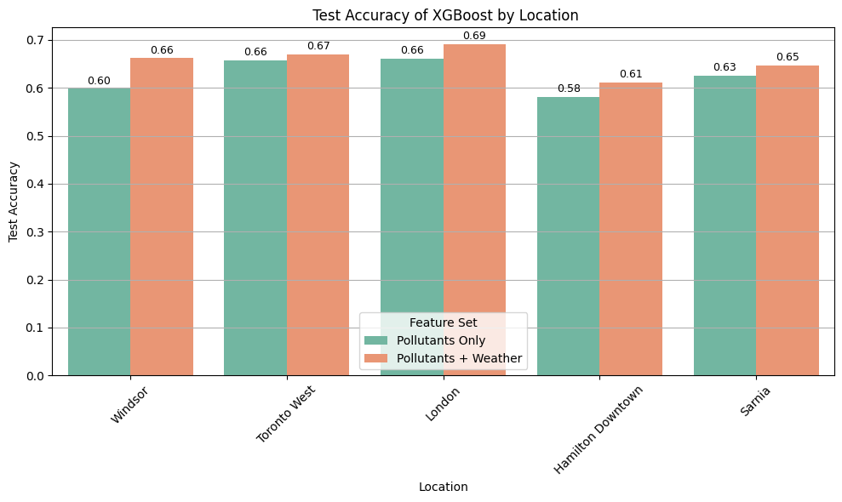
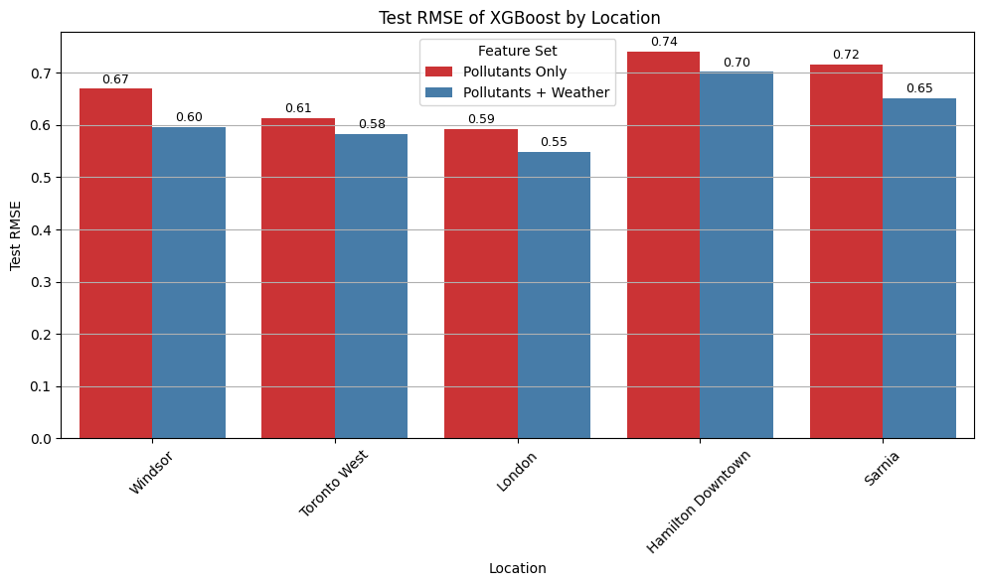
Regression: Stage 1 & 2
Compared 8 models using pollutant-only features
Models performed best:
XGBoost: Top performer in London and Sarnia
CatBoost and Gradient Boosting: Consistent results
Added temperature data to improve regression performance
Results:
Windsor: Accuracy improved from 60% to 66%
RMSE decreased across all cities

Slide 9
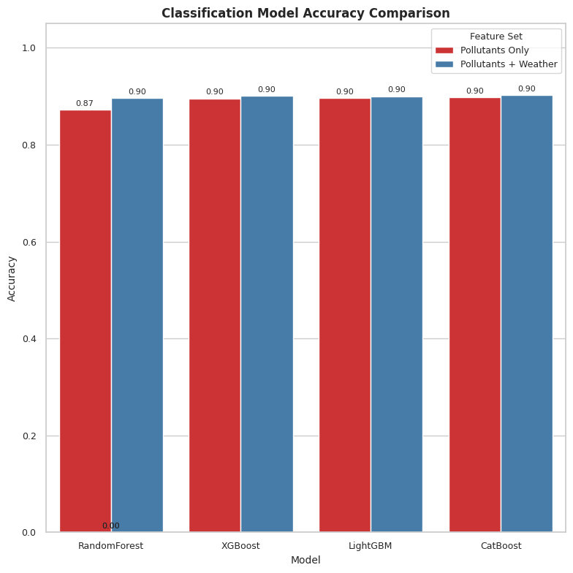
Classification of AQHI Levels : Stage 3
Reformulated AQHI prediction as classification
(Low, Moderate, High)
Classification outperformed regression:
CatBoost, XGBoost, LightGBM: ~90% accuracy
Minimal impact of temperature on performance

Slide 10
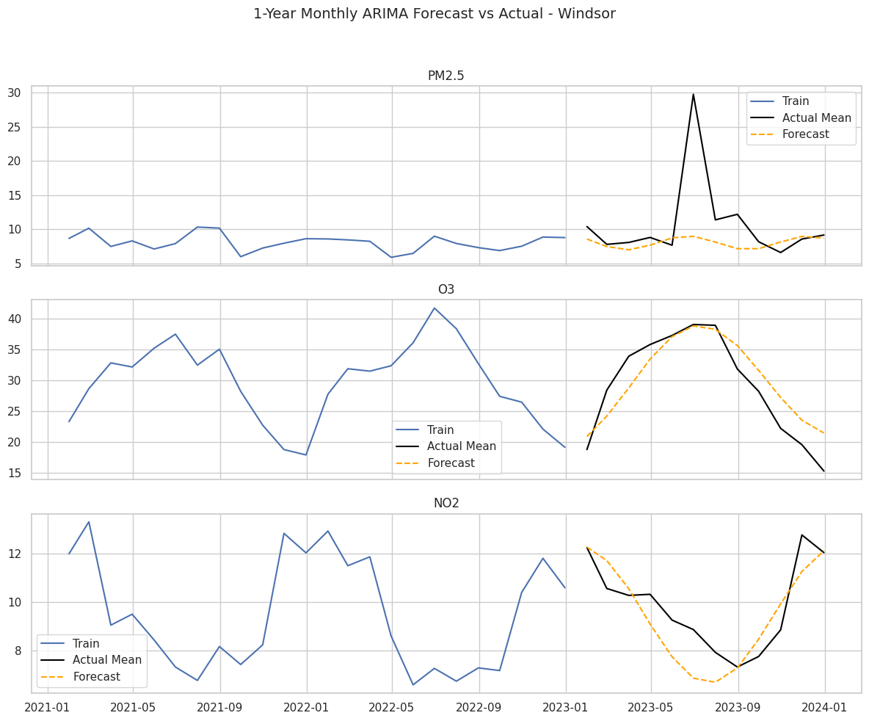
Forecasting with ARIMA
Forecasted PM2.5, O3, NO2 using ARIMA (2021–2022 training, 2023 testing)
Results:
O3 and NO2: Seasonal trends well captured
PM2.5: Failed to predict wildfire spikes in mid-2023
ARIMA is useful, but limited under extreme conditions

Slide 11
Conclusion
City-specific variability noted (e.g., industrial impact in Sarnia, Hamilton)
Ensemble classifiers (XGBoost, LightGBM, CatBoost) achieved highest accuracy
Regression models showed modest improvements with temperature
AQHI categories effectively predicted using pollutant-only features
ARIMA worked well for seasonal patterns but failed under anomaly (wildfire)
Classification models are ideal for deployment in public health systems

Slide 12
Future Scope
Real-time
Deep learning models
Build real-time dashboards and mobile apps for public use
Integrate ARIMA forecasts
Explore deep learning models (LSTM, hybrid approaches)
Integrate pollutant forecasts (e.g., ARIMA) into AQHI models

Slide 13
Thank you

